Slide 1

Python WORKSHOP

Slide 2
title
PENALTY SOCCER game

Slide 3

team name
RAMPAGE’S SOCCER TEAM

Slide 4
Team number
15

Slide 5
TEAM MEMBERS
ABISHRAJ.K (ER) [18IT01]
ALTEN.C (ER) [18IT02]
ANUSUYA (ER) [18IT03]

Slide 6
ACADEMIC MENTOR :
(ER) SATHISH.R M.E.,(PhD).,
Assistant professor,
Dept of IT.KITE

Slide 7
INDUSTRY MENTOR
MS SUBASHINI.U
ASSOCIATE
KGISL GSS

Slide 8
ABSTRACT
The title of our game is penalty soccer game .This project is about a penalty game in football . This project was developed by using python pygame . There are one players in the game . We are focusing developing a 2D Penalty Soccer Game . Each player will have a 5 penalty shoots. In this game Goal Keeper will save the ball or allow the ball . If Goal Keeper allow the ball the point will increase by 1 for each player . If Goal Keeper save the ball the point will not increase and decrease for each player.In order to improve the match success rate, we proposed a penalty kick strategy based on two-player shooting method which is used in two different defense patterns. In this strategy, a shooting method is applied when the opponent goalkeeper run out to destroy the ball and a reflecting shooting method is used when the goalkeeper stays at the goal line.

Slide 9
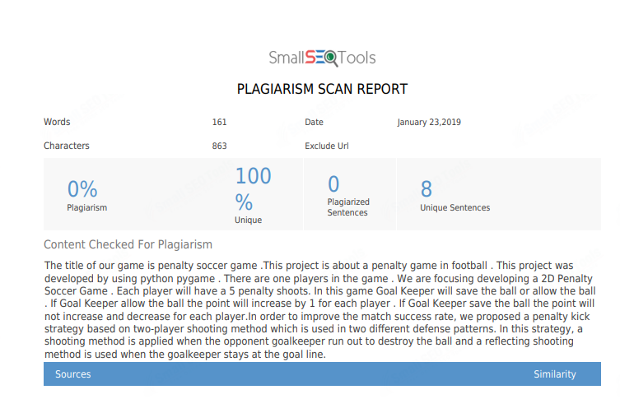

Slide 10
MODULES
GAME TYPE : PENALTY SOCCER GAME
PLAYERS : ONE PLAYER
LEVEL : ONE LEVEL
PENALTY SHOOT : EACH PLAYER HAS 5 SHOOT
TIME : THERE IS NO TIME
SCORE : BASED ON GOAL WE CALCULATE THE SCORE

Slide 11
REQUIREMENTS
HARDWARE :
PENTIUM 4
SOFTWARE :
THONNY
LANGUAGE :
PYTHON

Slide 12
MODEL ARCHITECTURE
Start the game
Two players
Player 1 shoot the ball
Goal keeper allow or save the ball
Player 2 shoot the ball
Goal keeper allow or save the ball
After 5 shoots for each player
End the game.

Slide 13
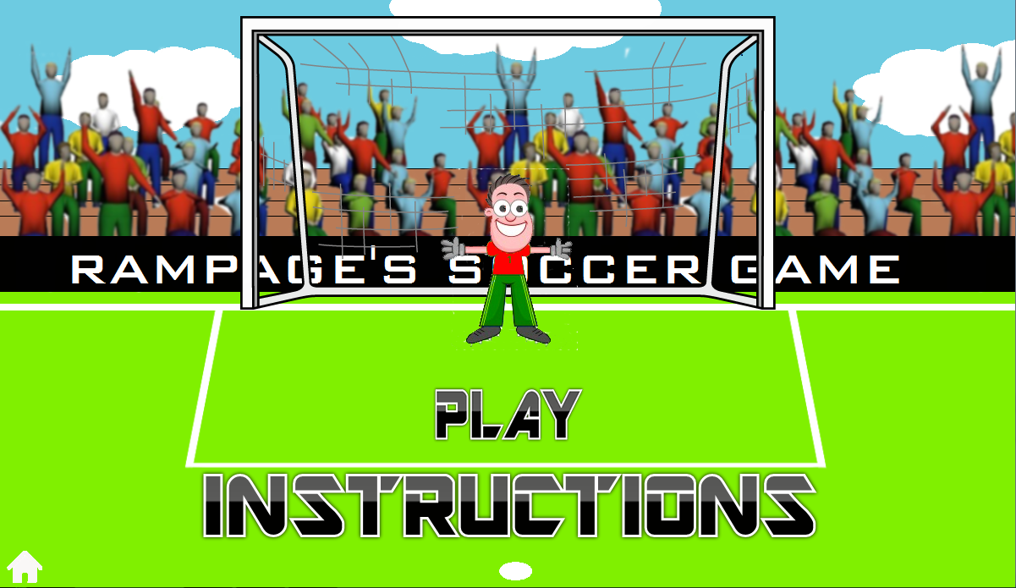
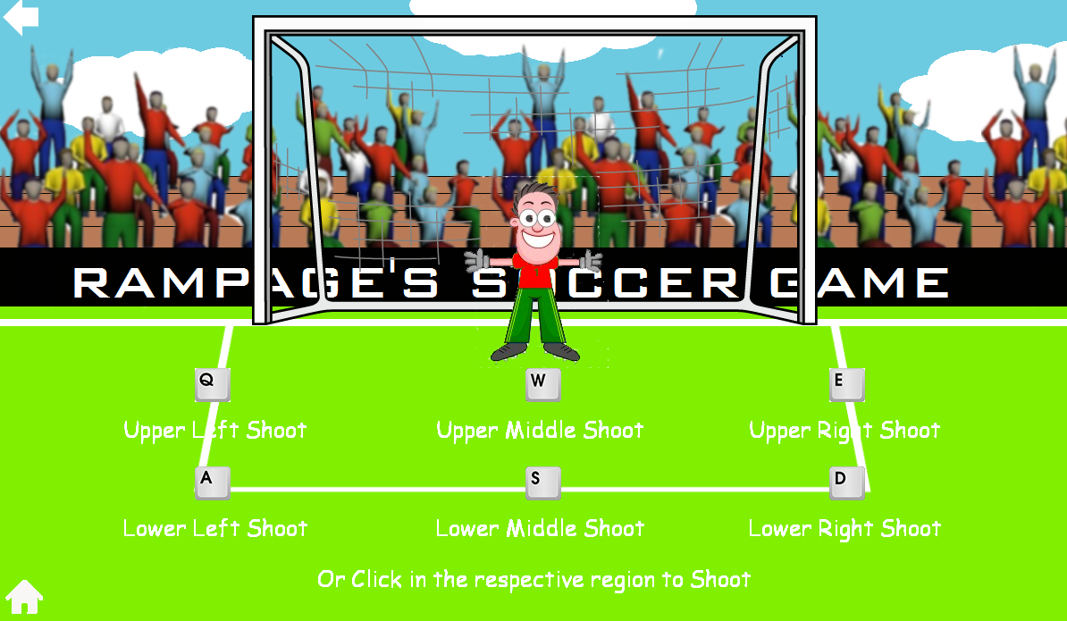
pygame

Slide 14
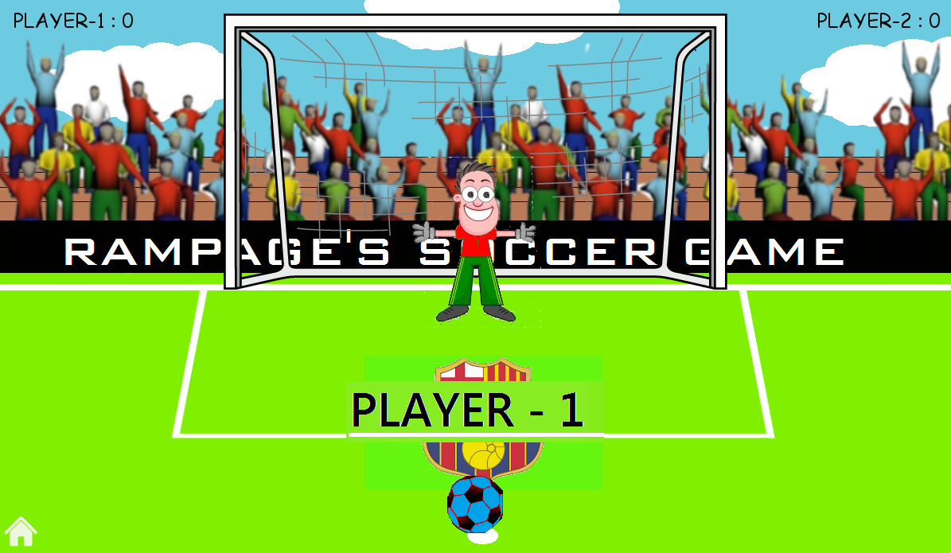
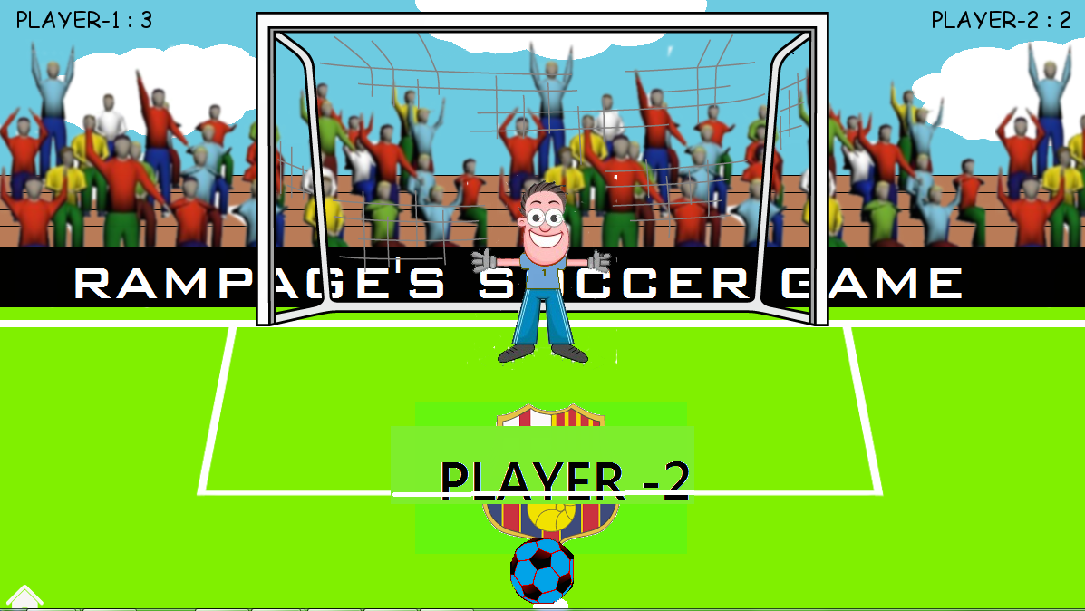
PYGAME

Slide 15
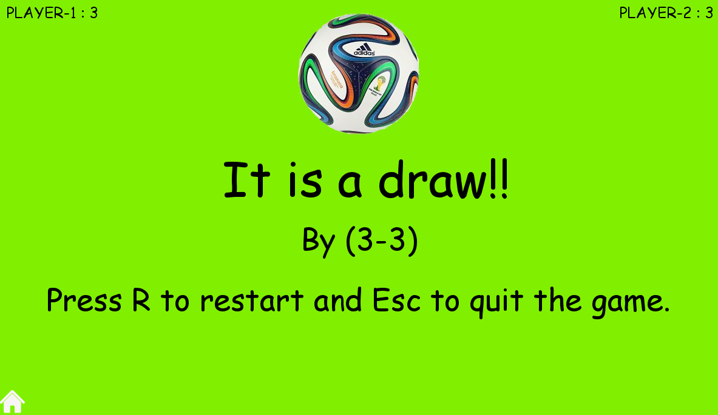
PYGAME

Slide 16
Thank you…….

